Slide 1
Mesolithic Culture
Middle Stone Age Culture

Slide 2
Introduction
The term ‘Mesolithic’, Mesos – Middle, Lithic – Stone (Middle Stone Age) was added by Hodder Westropp in 1866 – to mark a middle phase between Paleolithic (Old Stone) Age and Neolithic (New Stone) Age
Shorter phase than Paleolithic Age
In Europe, it began about 8000 BC and lasted about 2700 BC
In India, the age began around 9000 BC and ended around 4500 BC
The technological hallmark of this age were tiny stone tools or ‘microliths’
Non-microlithic tools like ‘flakes’ and ‘blades’ were also used
Technological innovations such as ‘bow’ and ‘arrow’ were used for hunting
People invented querns, grinders, hammer-stones for grinding and pulverizing roots, tubers and seeds.
Fire was used regularly
Art – evident in paintings and engraving

Slide 3
Microlithic Tools
Tools were categorised into two groups – stone and bone/antlers
Stone tools were further divided into microliths and macroliths
Microliths found were in different geometrical shapes – trapeze, triangle, crescent.
Non-geometrical types consisted of knives, blades, awl, burin and borers
Small pointed pieces of stones were used for gathering plants, harvesting, slicing, grating, fibre processing for lines, snares, nets, traps, shell-openers, bow-drill points and awls.
Pieces of these stones were attached to wood, bones and antlers
The Mesolithic people used extremely sharp and hard materials like flint, chalcedony, agate, carnelian etc
They were produced in huge quantities and kept ready for use in times of wear and tear. Worn out tools were pulled out from wood, bones and antlers and new ones fitted. In comparison, paleolithic tools needed a complete replacement

Slide 4
Subsistence Pattern and Social Complexity
Mesolithic people lived on gathering and hunting
In some areas, permanent settlement arose while other areas continued to maintain mobile and nomadic lifestyle
According to Binford, human beings settled around river valleys due to availability of aquatic food. Availability of water resources made them live sedentary life
C. Gamble opines that people shifted to river valleys due to growth of population and shortage of food which rivers offered them
David Yesner argues that with the changing environment, population pressure, food shortage and shift to aquatic resources was the ‘optimal strategy’ for early man

Slide 5
Mesolithic Culture in Europe
The Northern European Culture from 10,000 BP were characterised by tool technologies of bows and arrows, domestication of Dogs, use of canoes, besides a range of fishing tools such as nets, hooks, traps etc
Tools like axes, celts (long/thin stones), projectiles (of bone/wood/wood/antlers) also appeared at the end of Mesolithic age around 6000 BP
Northern Europe experienced change in sea level due to melting of glacial ice. It led to use of aquatic resources
Mesolithic culture of Europe showed dynamic adaptation to changing environmental conditions from tundra park land, open steppe, forested zones and coastal environment considered by (Clark:1980) as ecological niche formation by the contemporary man.

Slide 6
Mesolithic Culture in Scandinavia and Britain
Mesolithic period in Scandinavia and Britain were characterised by well-marked population pressure and permanent settlement.
Coastal villages revealed mixed economy based on exploitation of marine and forest resources
By the end of 4000 BP, people began to make pottery.
The Mesolithic culture had 3 sub-divisions – Maglemose, Kongemose and Ertebolle periods.
The Maglemose and Kongemose culture were characterised by river-valley settlements. Hunting was the main economy
People of all the 3 periods buried their dead..sometimes, dogs were buried along with a dead man.
Evidence of settled life were seen by remains of villages in Denmark, cemeteries found in Denmark, and Sweden proved they bury their dead, Pots were also found at different places during this period

Slide 7
Mesolithic culture in Southwest Asia
By 13,000 BP, Southwest Asia saw environmental and vegetational changes.
The economy was based on hunting and gathering.
Southwest Mesolithic culture was marked by the emergence of Mushabian culture (14,500 - 12,800 BP Eastern Mediterrannean), Kebaran culture (13, 500 – 11, 500 BP), Natufian culture (12,500 – 10, 200 BP in the Levant)
Mushabian culture was marked by small geometric microliths, Kebaran culture was marked by removing bladelets from the core and Natufian culture (in the Levant) revealed the beginning of agriculture. It was seen as a period of transition from Mesolithic to Neolithic phase. The culture was marked by sedentary lifestyle with village settlements, microlith tools like burin, borer, scraper, blade, knife, arrowheads, querns, pestles, pounders/mortars, ground stones, stone vessels, fish hooks, and nets. Evidence suggests that men were still hunters and hunted animals like wild goat, deer and gazelles.

Slide 8
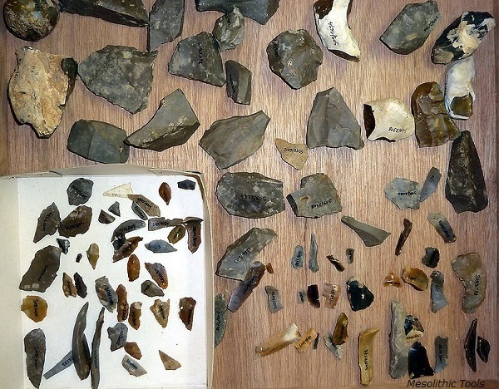
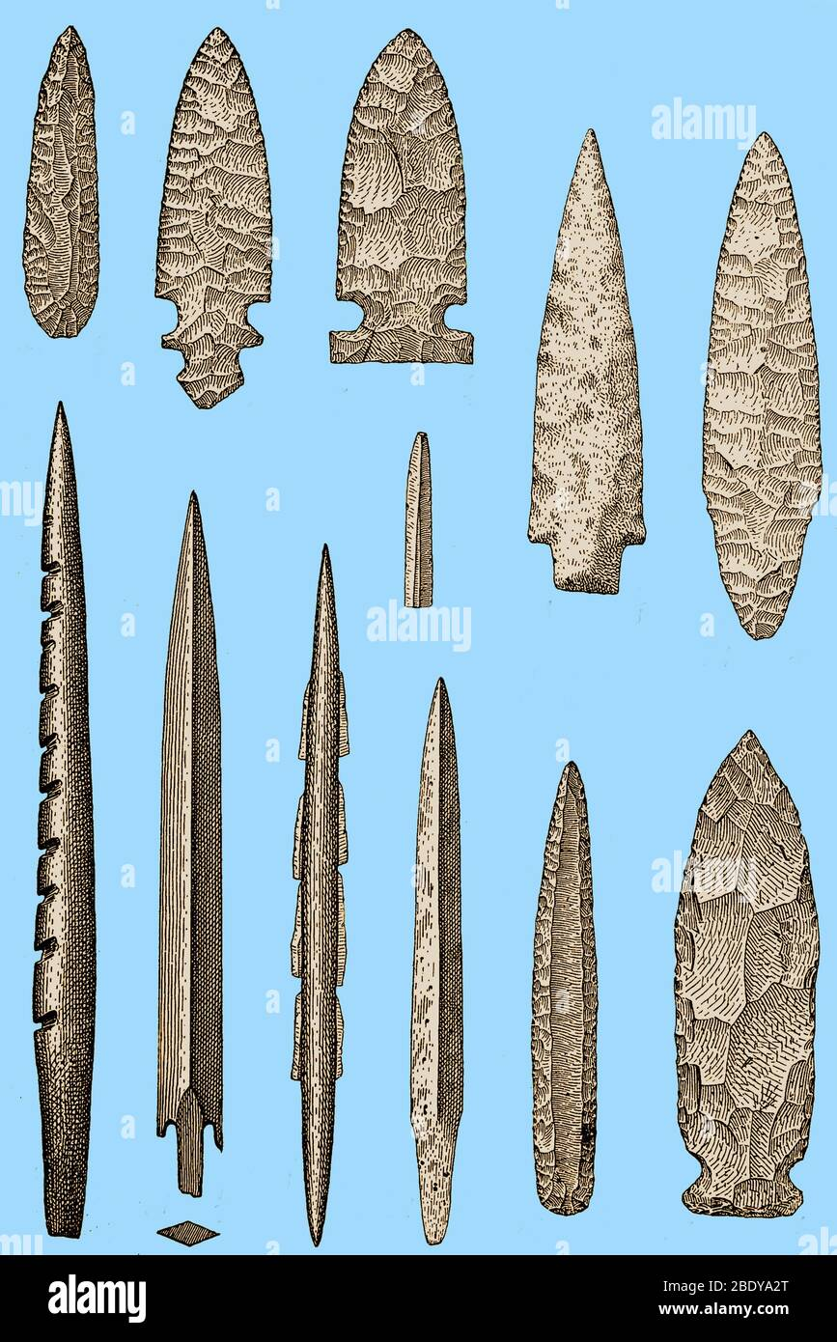
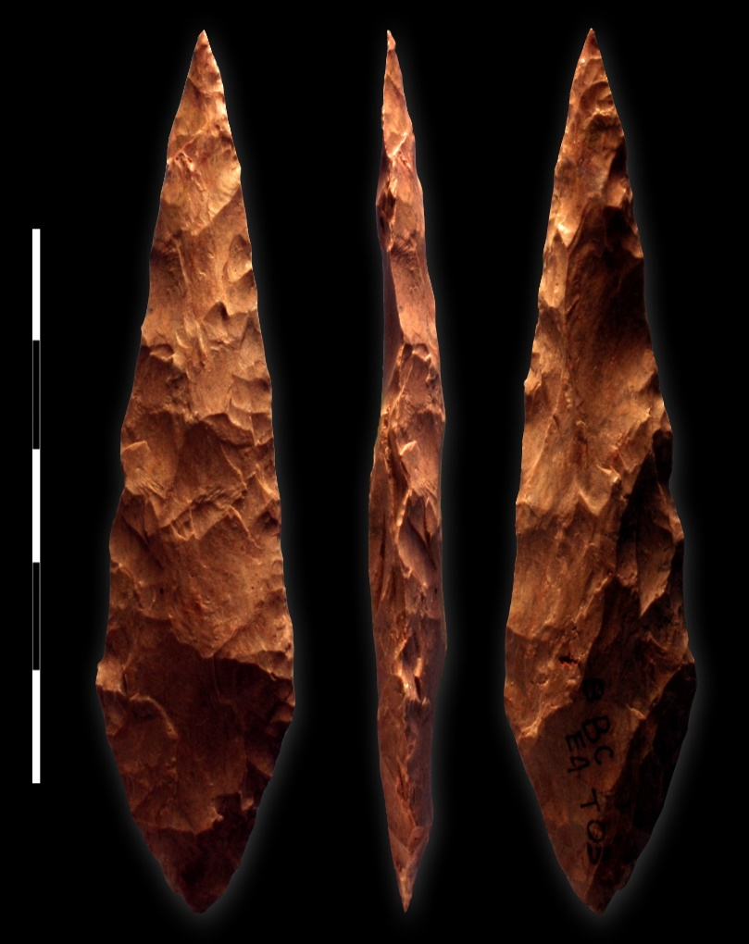
Mesolithic Tools, Europian context

Slide 9
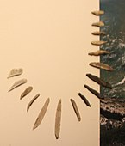
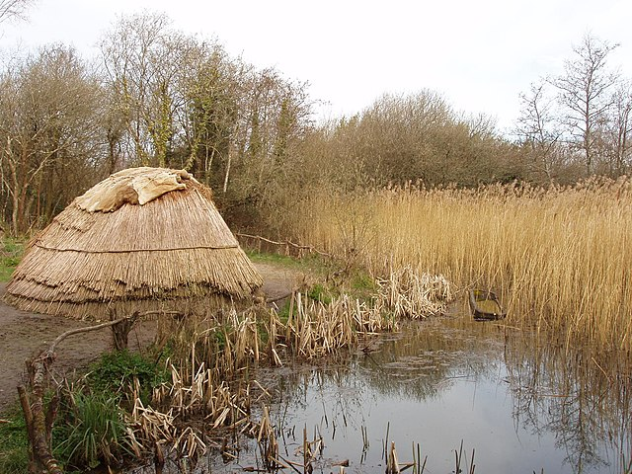
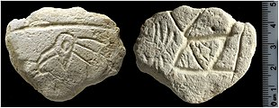
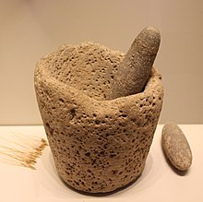
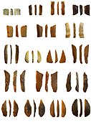
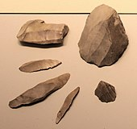
Mashubian Geometric tools, Kebaran bladelets from core, Natufian settlement and tools

Slide 10
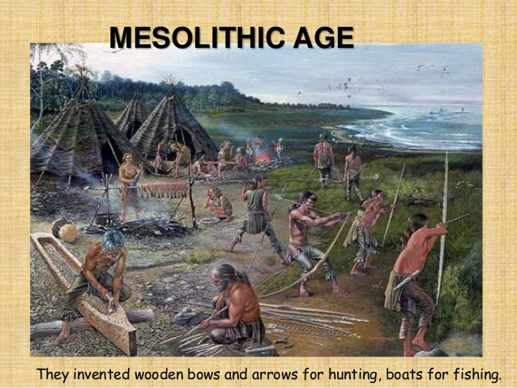
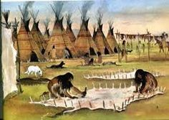
Mesolithic Culture in India
Remains in Larganj, Gujarat
Adamgarh in Madhya Pradesh
Some parts of Rajasthan, UP, Bihar
Man invented the Bow, Arrow, Boat

