Slide 1
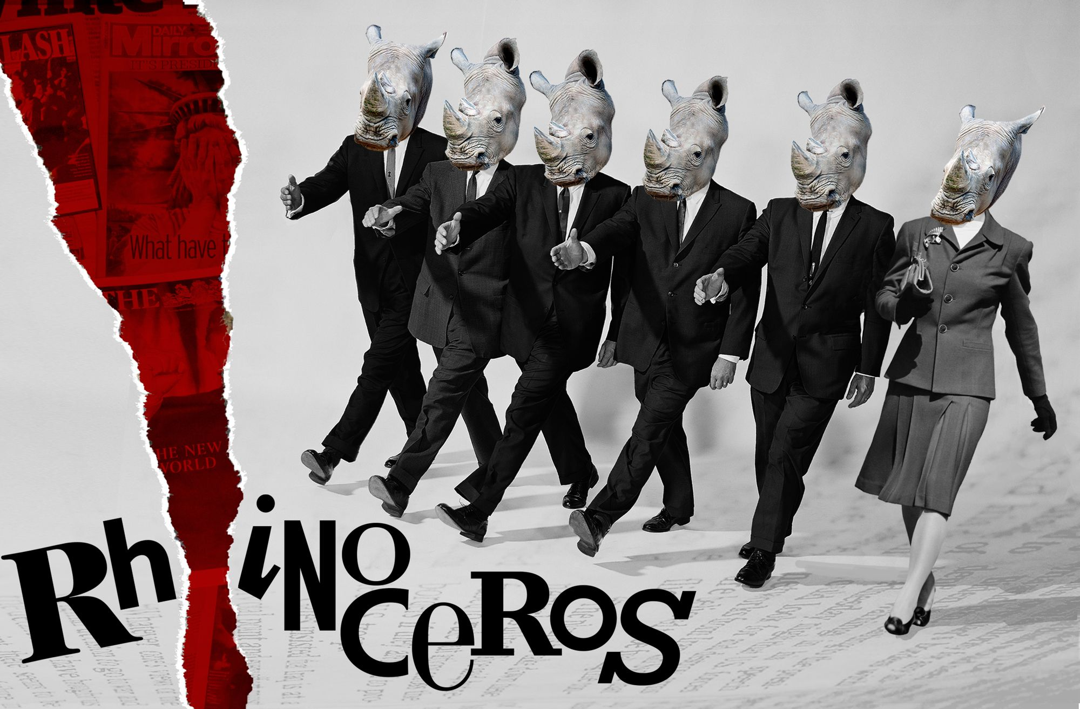
By Eugene Ionesco
Theme of Rhinoceros
Presented by:-
PREM PD. SHARMA
Assistant Professor,
Dept. of English,
Silapathar College, Silapathar.

Slide 2
Theme of Rhinoceros.
Rhinoceros is a play by Eugene Ionesco, written in 1959. The play was included in Martin Esslin study of Post War avant garde drama. The Theatre of the Absurd although scholars have reject this label.
The play Rhinoceros has three acts only and each act has two scences. Barenger, Jean, Dudard, Botard, Mr & Mrs. Popilian John and Daisy are the characters of Rhinoceros.
Regard the Theme of the Play Rhinoceros we can classify them in the following way.

Slide 3
Will and Responsibility:
The transformation of Barenger from an apathetic alcoholic and ennui – ridden man into the saviour of humanity constitues the major theme of Rhinoceros and the major existenant struggle. One must commit one self inorder to give life meaning which Berenger , has done. In the beginning Barenger has no convention will power due consumption of Alcholol. On the other hand Jean continuously advises Barrenger to exercise more will power and not to surrender to life pressure and the other character like Dudard seem to do just that as they control their destinies. Where as Berenger does not have the will power as evident by frequently recourse to alcoholic and his tendency to dream (both daydream and nightmares). However he maintains a stead feast latent sense of day dream after Act one.

Slide 4
The next theme of the play is Will-Power. The slavery of the Rhino and Jeans transformation and statement in Act Two exemplify this desire to power. He becomes violent and declares humanism is dead and tries to kick Barenger for whom he had advised earlier to improve his life style. The plays final irony is that Barenger becomes true hero by gathering resources of Will-Power to serve humanity.
The other theme of the play is Absurdity. The other plays within this group are Absurd because they don’t focus on logical acts, realistic occurrence such as thinking as the rhinoceros from Asia as Arica, it has one horn or two horns. The play has no traditional character or hero, or development of plots. They instead focus on human beings trapped in an incomprehensible world subject to any occurrence, no matter how illogical. Their wodrld without meaning, it is isolated from individual and a good leader, etc. such character fond in the Rhinoceros are Dudard, Botard, Jean, Mr. Beuf and Daisy etc.

Slide 5
The play has also the theme of love which we find between Barenger and Daisy. Though a drunkard in the first Barenger is in love with Daisy. Often they have dispute and quarrel. They attempt to reconcile but once more fight. The reason for the same is that Daisy wants to be transformed into Rhinoceroes and she want Barenger to join with her which Barenger refuses even though he loves her heartly he cannot change his principle.
Whereas Mr. Beuf and Mrs. Beuf are husband and wife, each love the other. Mr. Beuf was chased by the Rhinoceros and he transformed to Rhinoceros. His wife being faithful and in love with her husband jumped on the back of the husband and transformed into the same.

Slide 6
Lastly, we can say that Fascism is the theme of the play. During his life time Ionesco was an open critic of in humanities associated with Nazism and Fascism, during World War- I and II. To read Rhinoceros as an attack on fascism politics enough Ionesco explores the psychology and mentality of those who succumb with little resistance to Nazism allowing their free thinking ideals and free diverted violent group. In the play characters repeat words and ideas that other characters have said earlier or look for guidance to authority and take side with the authority. Ionesco wanted to show how individual are seduced by the ranks of the powerful groups such as Nazism. The people turn blind eye to their rise to power by joining their ranks ,when Jews were killed in million they did not ;come out and protested, Hitler of his monopoly.
*******

Slide 7
THANKS
***

