Slide 1
UNIT: 4 Unconstrained Optimization
Mrs Anindita Chakravarty
Asst Professor
Silapathar College

Slide 2
The basic economic problems centre around the problem of choice between the alternatives in order to optimize certain objectives.
For eg:
Maximization of profit by a firm : Problem of determining price-quantity combination
Maximization of total utility: Problem of choice of two consumption goods with limited income.
Minimization of cost of production: Problem of choice of combination of inputs.
Optimization means finding an alternative/choice with the most cost effective or highest achievable performance under given constraints, either by maximizing desired factors or minimizing undesired ones.
Optimization is mainly concerned with finding maximum and the minimum points ( also known as optimum points) of a function.

Slide 3
All such optimizing problems can be categorized into three groups:
Optimization without constraint (s)
Optimization with constraint (s).
Equality Constraint (s)
Inequality Constraint (s)
Unconstrained Optimization means the simplest of optimization problems without conditions, or what we refer to as optimization problems without constraint(s).
A constrained optimization problem requires us to maximize or minimize our objective function subject to constraints that may be an equality (which implies it will be binding), or an in- equality (which implies in can be binding or not).

Slide 4
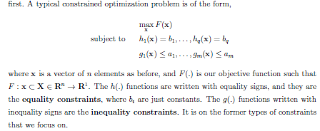

Slide 5
For your better understanding, I will provide a PDF covering the discussed topic..
Thank You

