Slide 1
WHAT IS MICROTEACHING?
By
MINU LOTA NEWAR
Assistant Professor
Department of Education
SILAPATHAR COLLEGE
SILAPATHAR – 787 059
ASSAM

Slide 2
Introduction
Microteaching is one of the most important development in the field of teaching practice. It originated in Stanford University in 1963 where an approach was evolved for practical teacher training.
Microteaching is more analytical method and completely new approach to provide the feedback. Though it is considered as a mechanism of feedback device for the modification of teacher trainee but it is real teaching.

Slide 3
Definition
Allen and Ryan (1969) defines microteaching as a “scaled down teaching encounter in class size and class time”.
Passi(1976) defined microteaching as “a training technique which requires student teachers to single concept using specified teaching skill to a small number of pupils in a short duration of time.”

Slide 4
Features of
Microteaching
1. New innovation.
2.Real teaching.
3.Scaled down teaching.
4.Individualised teaching device.
5.Providing feedback.
6. Device for preparation of teachers.
7. Selecting and mastering one skill at the time.
8.Using video tape and CCTV to make any observation.
9. Analytic approach to teaching.

Slide 5
Components of Microteaching
A Teacher
The Pupils(usually 5-7)
A brief lesson
The objective of the specific microteaching occasion
Feedback by the supervisor or the using audio or video tape recording.

Slide 6
Objectives of Microteaching
To give practice teaching to the teachers under training by lessening the complexities of classroom situation.
To identify the drawbacks of the teachers and to give the immediate feedback for modifying their behavior.

Slide 7
Objectives …
.
To develop experimental teacher education programmes and to encourage research identifying new skill.
To improve teaching through more control of instructional process and supervision.

Slide 8
Procedure of Microteaching
Defining a skill.
Demonstrating the skill
Planning the Lesson
Teaching the Skill
Discussion
Re-Planning
Re-Teaching
Re-Discussion
Repeating the Cycle.

Slide 9
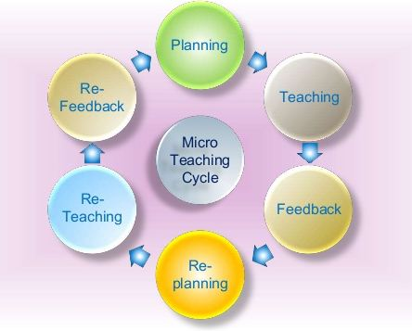
Diagrammatic Representation

Slide 10
Conclusion
Teaching is a very complex activity. Microteaching is a technique through which the teaching complexity is simplified.
From the research point of view, microteaching ensures better control over conditions and situations in terms of finding out the effect of teacher behavior on pupils’ achievement.

Slide 11
THANK
YOU

