Slide 1
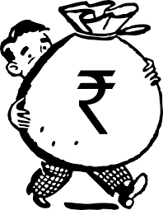
Topic: Functions of MONEY
Submitted by
Mrs Anindita Chakravarty
Assistant Professor (Department of Economics)
Silapathar College, Dhemaji

Slide 2
FUNCTIONS OF MONEY
Money performs four important functions each of which overcomes the difficulties of barter system. These are mentioned as below:
Medium of Exchange
Standard of Deferred Payments
Store of Value
Measure of Value
Let us discuss one by one in the succeeding slides

Slide 3
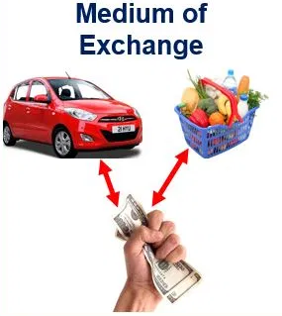
Medium Of Exchange function Of Money
Money is a widely accepted token which can be exchanged for goods and services
Because it can be exchanged for any good or service it acts as an intermediary instrument and avoids the limitations of barter, where what one wants has to be exactly matched with what the other has to offer.
The most important and essential function of a medium of exchange is to be widely acceptable and have relatively stable purchasing power (real value)

Slide 4
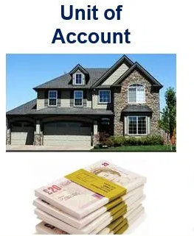
Measure of Value Function of Money
A unit of account is something that can be used to value goods and services, record debts, and make calculations. In economics, unit of account is one of the functions of money
Money as a measure of value, helps in determining the value of goods and services in the economy.
Money is taken as the common denominator while measuring the value of goods and services in the economy.

Slide 5
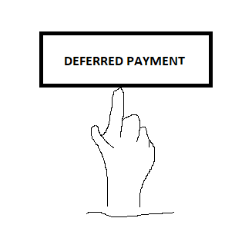
Standard of Deferred Payments Function of Money
Deferred payments are payments that are completely or partially postponed for financial reasons.
It is the function of money of being a widely accepted way to value a debt, thereby allowing goods and services to be acquired now and paid for in the future.
When there is severe inflation or deflation, money ceases to serve as a standard for deferred payments.

Slide 6
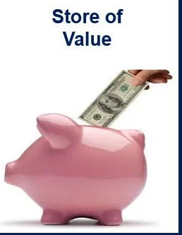
Store of Value Function Of Money
A store of value is something that people use to transfer purchasing power from the present to the future.
If the value of currency becomes unpredictable, such as in times of hyperinflation, investors and consumers will shift to alternative stores of value, such as gold, silver, precious stones and real estate.
Because of this store of value function of money, large quantities of money are hoarded
An example of a store of value is currency, which can be exchanged for goods and services.

Slide 7
THANK YOU

