Slide 1
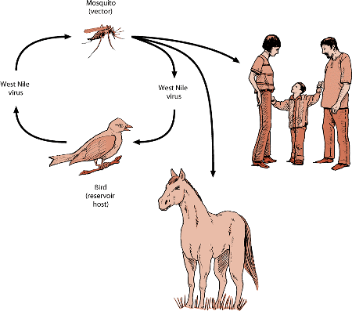
Mechanical and biological vector ,Reservoir , Host – vector relationship , vectoral capacity

Slide 2
Mechanical and biological vectors
A vector is an animal that carries a disease from host to host .
Mechanical vectors
An animals that carries a pathogen from host to host without being infected itself is a mechanical vector .
Eg. A fly lands on feces and then on your food ,depositing pathogens from the feces that you then ingest . Cholera , typhoid fever .

Slide 3
Biological vector
An animal that carries a pathogen that reproduces inside it before transmitting it to another host , typically via a bite , is a biological vector .
Eg. Mosquitoes – Malaria , zika , yellow fever , dengue fever.
Fleas – burberic plague

Slide 4
Reservoir host
An animal host , acting as a source of transmission of any disease/infection .
Most of the cases , Human acting as reservoir host .
Parasite does not causes any symptoms to the host , but remains in the host and spread the disease .
It harbors a pathogen but suffers no ill effects .They serves as a source of infection to other species that are susceptible ,with important implications for disease control.
A single reservoir host may be reinfected several times .

Slide 5
In the reservoir host , the parasite neither undergoes development nor causes any disease .
Eg. Monkey for plasmodium , African antelope for Trypanosoma gambienc .

