Slide 1
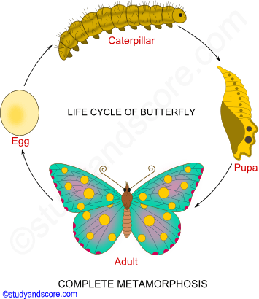
METAMORPHOSIS IN INSECTS

Slide 2
Metamorphosis
Dramatic changes in the body of insect like shape ,structure and function at different stages of life is called Metamorphosis .
Some of them undergo only minor changes while most undergo extreme changes in structure and function.
Juvenile insects molt frequently.
These changes may be accompanied by addition and/or subtraction of body parts .

Slide 3
It is completely hormone controlled process.
In different type of insects it is of different types :-
1.Complete Metamorphosis :-
The complete form of metamorphosis involves three very different life stages once the insect hatches from the egg : larva, pupa or chrysalis, and adult or imago.
The larval forms of most insects exhibiting complete metamorphosis is more wormlike than insect-like with tiny or no legs ,and often use a worm like wriggling movement to move .

Slide 4
Larva molt to form a ‘resting’ stage called a pupa or chrysalis . This is a stage incapable of coordinate locomotion . Feet , antennae, and wings (when present) are closely attached to the animals outer surface .

Slide 5
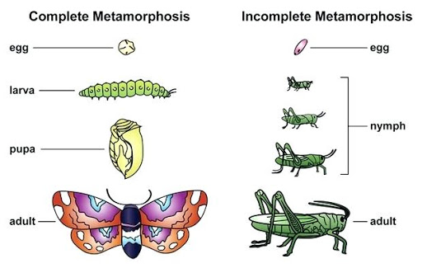

Slide 6
2. Incomplete Metamorphosis
It is also called abrupt metamorphosis .
Insects pass through several nymphal stages before the nymph molts to the winged adult.
These insects are usually aquatic with external gills.
The head becomes proportionately smaller and the abdomen larger with successive molts.

Slide 7
As they approach adulthood , wings appear on the back ,much as they do if the animal were to undergo gradual metamorphosis .
Naids and adults are completely different .

Slide 8
3.No metamorphosis
A few insects are ametamorphic and do not exhibit any metamorphic changes .The aphids are prime examples of this .
It is product when an unfertilized egg hatches inside the mother ,grows to a young female that looks exactly like her mother except in size , and the offspring emerges onto the host plant the mother is feeding on.

Slide 9
After eating for about a day , the young aphid has molted one or more times ,and begins to produce her own offspring – even before she has reached full size or has finished molting.
This mode of reproduction is so efficient that under favourable conditions, an aphid colony can multiply to ten times numbers in three days .

Slide 10
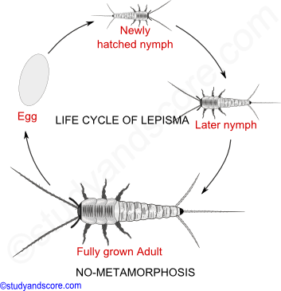

Slide 11
4.Gradual metamorphosis
Simplest form of metamorphosis .
In this gradual change occur between molts.
Juvenile insects are very much similar to adults hence only trained entomologist can distinguished different stages.
Eg. Grasshopper and praying mantis .
During molting head to abdomen ratio decreases.

Slide 12
