Slide 1
Price-Output Determination under Price Leadership by the Dominant Firm
PREPARED BY
ANINDITA CHAKRAVARTY

Slide 2
We now proceed to explain the determination of price and output when there exists price leader­ship by a dominant firm which is having a large share of the market with a number of small firms as followers each of which has a small share of the market.
To explain this we assume that the dominant firm knows the total market demand curve for the product.
Further, the dominant firm also knows the marginal cost curves of the smaller firms whose lateral summation yields the total supply of the product by the small firms at various prices.
This implies that from his past experience the dominant firm can estimate fairly well the likely supply of the product by the small firms at various prices.
With this information, the leader can obtain his demand curve

Slide 3
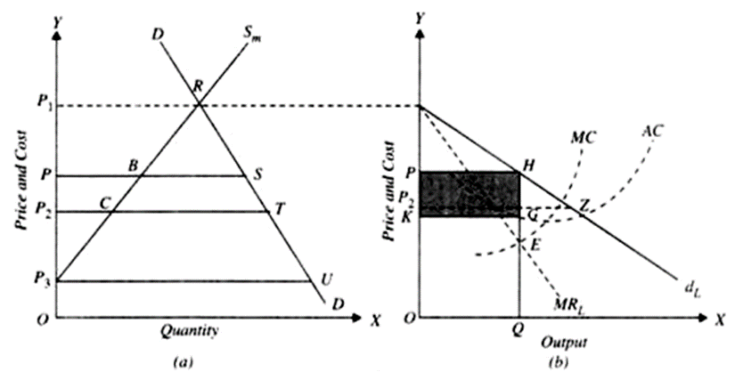

Slide 4
Consider panel (a) of Fig. where DD is the market demand curve for the product, S_{m} is the supply curve the product of all the small firms taken together. At each price the leader will be able to sell the part of the market demand not fulfilled by the supply from the small firms. Thus at price P₁ the small firms supply the whole of the quantity of the product demanded at that price. Therefore, demand for leader’s product is zero. At price P₂, the small firms supply P₂C and therefore the remaining part of CT of the market demand will constitute the demand for the leader’s product. The demand for leader’s product has been separately shown in panel (b) of Fig. 6 by the curve d_{L}. P₂Z in panel (b) is equal to CT in panel (a). At price P₃, the supply of the product by the small firms is zero. Therefore, the whole market demand P₃U will have to be satisfied by the price leader. Likewise, the other point of the demand curve for the price leader can be obtained. In panel (b) of Fig. 6 the MR_{L} is the marginal revenue curve of the price leader corresponding to his demand curve d_{L}. AC and MC are his average and marginal cost curves. The dominant price leader will maximize his profits by producing output OQ (or PH) and setting price OP. The followers, that is, the small firms will charge the price OP and will together produce PB. [PH in panel (b) equals BS of panel (a) in Fig.

Slide 5
THANK YOU

