Slide 1
EXCRETORY SYSTEM IN EARTHWORMS
The nephridia are of three types based on their position – septal nephridia,pharyngeal nephridia and integumentary nephridia.
Septal nephridia discharge the waste products through canal and ducts into the lumen of the intestine.
Pharyngeal nephridia discharges wastes into the mouth and buccal cavity.
Integumentary nephridia discharge nitrogenous metabolic waste products directly outside from the body through nephridiopores.
Eatrhworm excrete about 40%urea ,about 20% ammonia and about 40%amino.

Slide 2
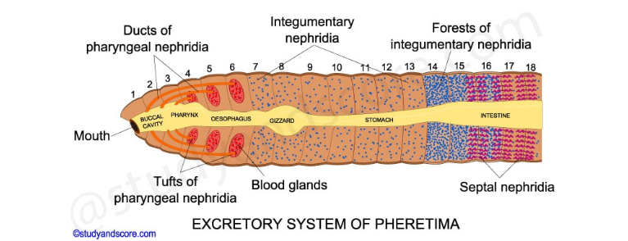

Slide 3
CONCLUSION
Annelids have a system for tubular reabsorption by a capillary network before excretion.
Earthworms excrete urea as main excreta ,but they are less preferably ureotelic than other terrestrial animals.
Though urea is present In the urine of earthworms,ammonia remains an important excretory product .
The level of urea depends on the physical conditions of the worm and the environment of its habitat.

