Slide 1
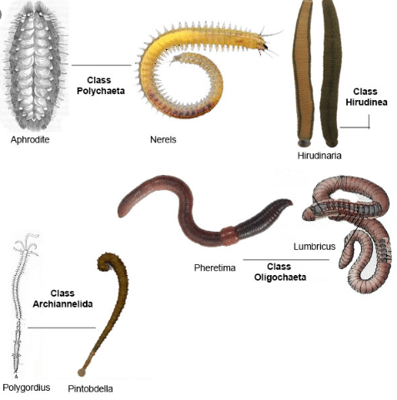
CLASSIFICATION OF ANNELIDA
PRESENTED BY SAIMOUN

Slide 2
Classification
About 8700 known species of annelida are divided into four main classes , primarily on the basis of presence or absence of parapodia , setae , metameres ,and other morphological features :-
Class 1 . Polychaeta (polys , many +chaite ,hair)
A . Chiefly marine ,some in fresh water .
B. Segmentation internal and external .
C. Head distinct with eyes , palps and tentacles.

Slide 3
D. Setae numerous , on lateral parapodia .
E. Clitemllu absent .
F. Sexes are separate . Gonads temporary and in many segments.
G. Trochophore larva present .
Polychaetes has divided into two subclasses –
Errantia :-example –Aphrodite(sea mouse),Phyllodoce ,Tomopteris ,Syllis ,Nereis ,Glycera ,Diopatra.

Slide 4
Sedentaria :-example –Chaetopterus , arenicola , owenia, sabella ,sabellaria , terebella, amphitrite ,serpula.

Slide 5
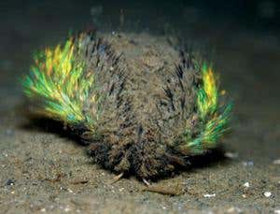
Sea mouse

Slide 6
Phyllodoce

Slide 7
Syllis

Slide 8
Chaetopterus

Slide 9
Class 2. – Oligochaeta (oligos, few +chaite , hair)
1.Mostly terrestrial , some in fresh water .
2. Segmentation external as well as internal .
3. Head indistinct, without sensory organs .
4.Setae few, embedded in skin . Parapodia absent.
5.Glandular clitellum present for cocoon formation.
6. Hermaphroditic . Testes anterior to ovaries.

Slide 10
7. Fertilization external (in cocoon); development direct ,no larval stage.
Example :-Aelosoma ,Nais ,Dero, Tubifex,Enchytraeus ,Branchiobdella,Lumbricus, Pheretima ,Megascolex

Slide 11
Aelosoma

Slide 12
Nais

Slide 13
Tubifex

Slide 15
Class 3 :-Hirudinea(Hirudo , leech)
1.Fresh water, marine or terrestrial . generally ectoparasite, blood sucking or carnivores.
2.Body with fixed number of segments(33).Each segment subdivided externally into annuli.
3.Segmentation external without internal septa .parapodia and setae absent .
4.Both anterior and posterior ends of body with suckers.

Slide 16
5.Coelom much reduced due to its filling by botryoidal tissue , and forms haemocoelomic sinuses .
6.Hermaphroditic with one male and female gonopore . Fertilization internal . development in cocoons , direct without larval stages.
Example :-Acanthobdella,Glossiphonia ,Placobdella,Hirudinaria ,Hirudo , Haemadipsa , Piscicola , Pontobdella ,Dina, Erpobdella.

Slide 17
HIRUDINARIA

Slide 18
HIRUDO

Slide 19
ACANTHOBDELLA

Slide 20
Glossiphonia

Slide 21
Placobdella

Slide 22
Class 4:Archiannellida
About one dozen genera of small ,marine worms of unknown affinities .
Segmentation chiefly internal . No parapodia and setae.
Sexes usually separate.
Usually trochophore larva.
Example:-Polygordius ,Dinophilus ,Protodrilus

Slide 24
THANKS YOU

