Slide 1
Cost-Push Inflation
Unit:4
Prepared by anindita chakravarty

Slide 2
Definition
Cost-push inflation occurs when we experience rising prices due to higher costs of production and higher costs of raw materials.
Cost-push inflation is determined by supply-side factors, such as higher wages and higher oil prices.
Cost-push inflation is different to demand pull inflation which occurs when aggregate demand grows faster than aggregate supply.
Cost-push inflation can lead to lower economic growth and often causes a fall in living standards, though it often proves to be temporary.

Slide 3
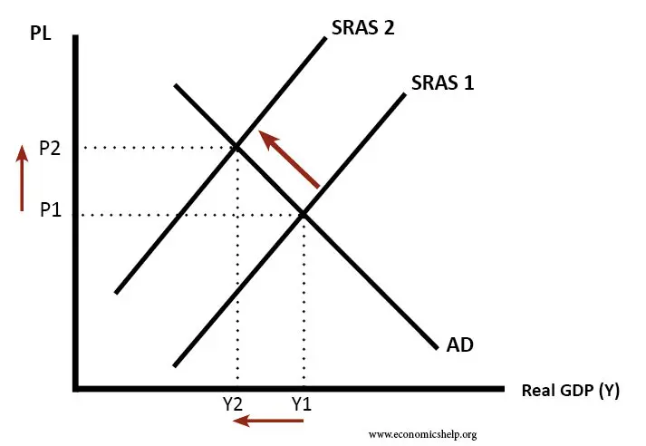
Diagram Showing Cost-Push Inflation
Assuming demand is constant (AD)
Short-run aggregate supply curve (SRAS) shifts to the left, causing a higher price level and lower real GDP.
Price rises to P₂
Output falls to Y₂

Slide 4
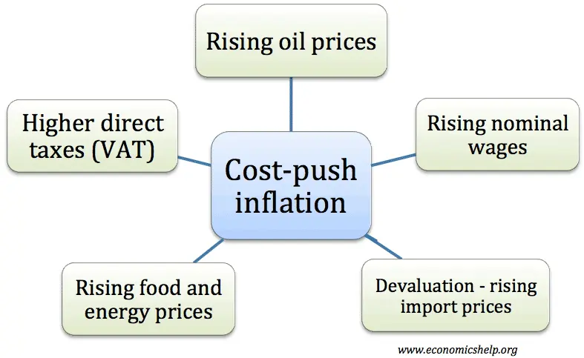
Causes of Cost-Push Inflation

Slide 5
EXPLANATION OF THE CAUSES
Higher Price of Commodities. A rise in the price of oil would lead to higher petrol prices and higher transport costs. All firms would see some rise in costs. As the most important commodity, higher oil prices often lead to cost-push inflation (e.g. 1970s, 2008, 2010-11)
Imported Inflation. A devaluation will increase the domestic price of imports. Therefore, after a devaluation, we often get an increase in inflation due to rising cost of imports.
Higher Wages. Wages are one of the main costs facing firms. Rising wages will push up prices as firms have to pay higher costs (higher wages may also cause rising demand)
Higher Taxes. Higher VAT and Excise duties will increase the prices of goods. This price increase will be a temporary increase.
Profit-push inflation. If firms gain increased monopoly power, they are in a position to push up prices to make more profit
Higher Food Prices. In western economies, food is a smaller % of overall spending, but in developing countries, it plays a bigger role. (food inflation)

Slide 6
THANK YOU

