Slide 1
Mode of Nutrition
Dr. Lipika Lahkar
Assistant Professor
Department of Botany
Silapathar College

Slide 2
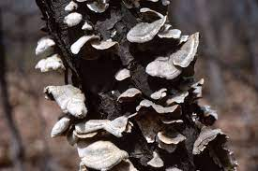
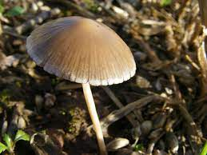
Saprophytoic Fungi
The saprophytic fungi live on dead organic materials produced by decay organic matter such as rotten foods, rotten vegetable, moist food, moist lathers,

Slide 3
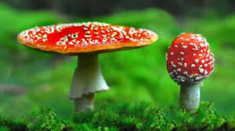
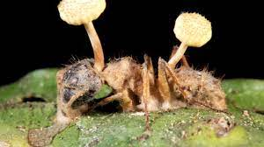
Parasitic Fungi
The parasitic fungi absorb their food material from the living tissues of the host on which they parasitze.

