Slide 1
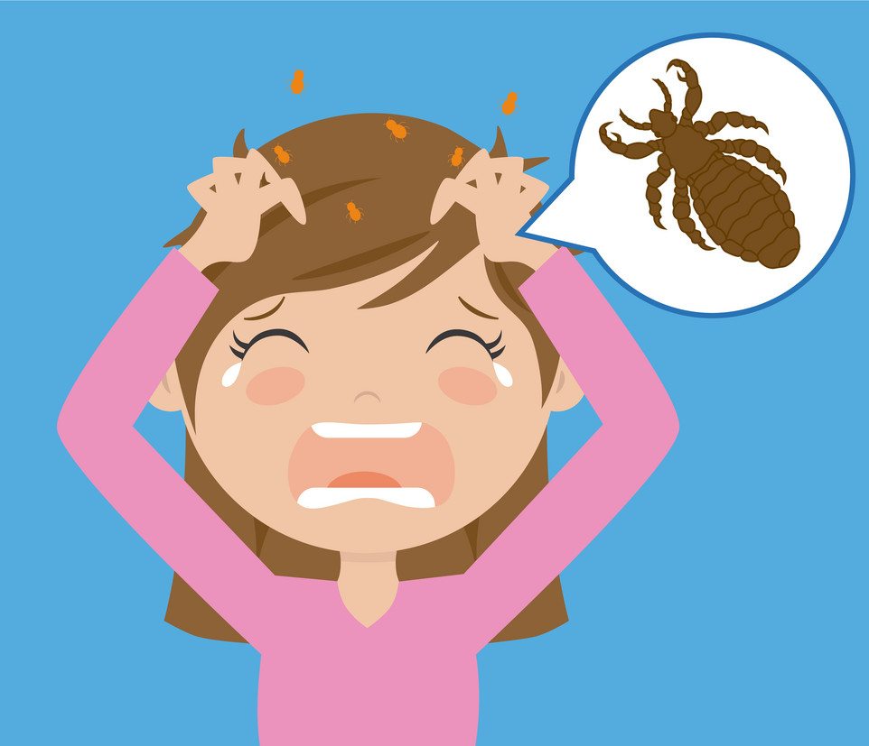
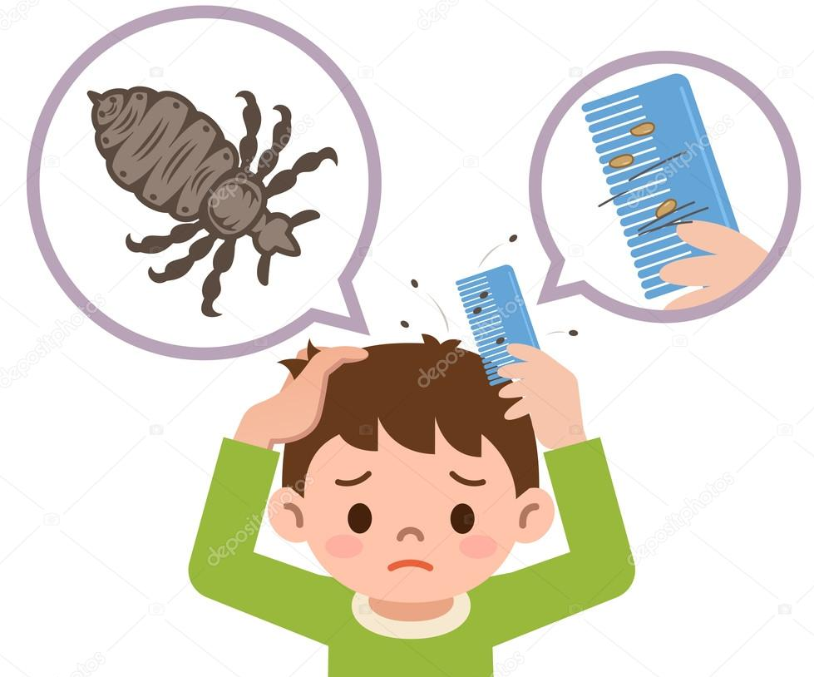
B.Sc. 2nd Semester (GE)
Subject: Zoology
Paper: Insect vectors and Diseases
Topic:
Human louse as insect vector
Dr. Merina Narah
Assistant Professor
Dept. of Zoology
Silapathar College
Silapathar, 787059, Assam.

Slide 8
Thank You

