Slide 1
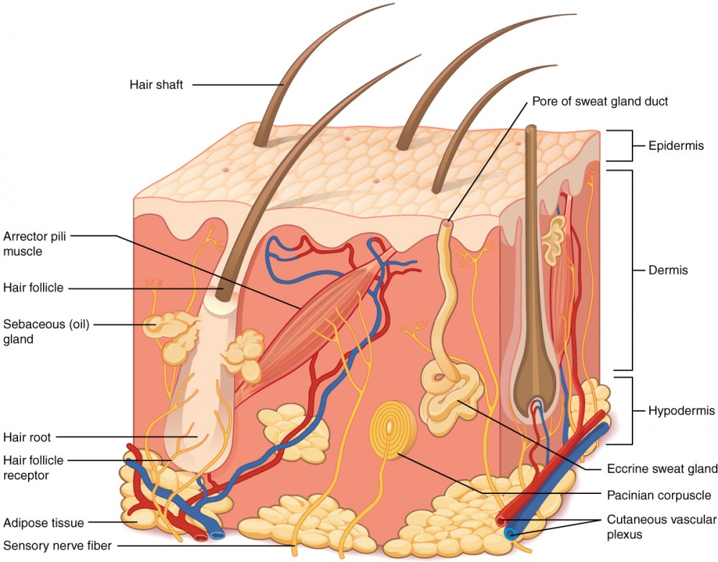
EPIDERMIS OF SKIN
Mr. saimoun ken manhai

Slide 2
INTEGUMENTARY SYSTEM
The integument system consists of the skin and its accessory organs or derivatives .
The skin is composed of three layers of tissue :-
- Epidermis (outer layer)
- Dermis (middle layer)
- Subcutaneous layer or Hypodermis (inner layer )
Epidermis is made of stratified squamous epithelium .
Dermis is made of fibrous connective tissue .
Subcutaneous layer or hypodermis made of adipose tissue and loose connective tissue .

Slide 3
Accessory organs include the hair root ,hair shaft,hair follicle, pili arrector muscle , sebaceous gland, sudoriferous gland , nails and mammary gland .
EPIDERMIS
Being made of stratified squamous epithelium, there is no blood vessels to supply nutrients to its cells.
Nutrients from the arterioles in the dermis layer diffuse upward into the epidermis layer esecially to the stratum basale and stratum spinosum layers .
Cuboidal cells at the stratum basale (stratum germinativum) layer receives most of the nourishment. These cells reproduce rapidly using mitosis.New daughter cells will be pushed upward into higher layers ,and they become flattened as they move upward.

Slide 5
Squamous cells moving upward in the epidermis receive less and less nutrients as diffusion distance increases. By the time they form stratum corneum ,the cells are dead and will be shed off from the skin .
Epidermal cells in stratum granulosum and stratum corneum undergo “keratinisation “ to produce a protein called keratin ,allowing these cells to be tough and waterproof . These cells are now called “keratinocytes” where they develop desmosomes between the cells and allow the epidermis to become a stronger physical barrier.

Slide 6
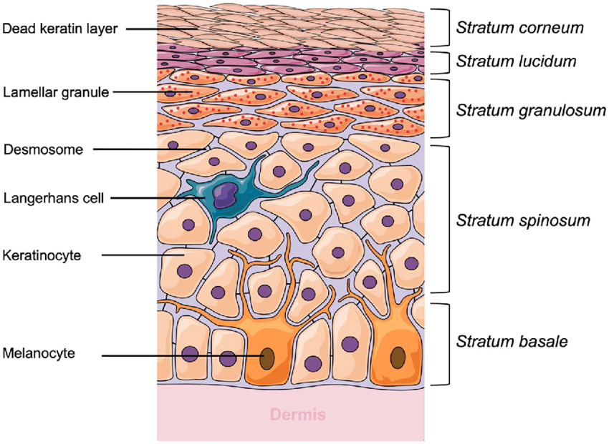

Slide 7
Four layer of cells are found in the epidermis of the skin : stratum basale ,stratum germinativum , stratum granulosum and stratum corneum . In the palms and soles, an extra layer beneath stratum corneum is formed called stratum lucidum.
Specialized cells called melanocytes in the stratum basale layer produce the skin pigment , melanin . The number of melanocytes and the amount of melanin production are genetically inherited .

