Slide 1
Unit- 2 public goods
Prepared by
ANINDITA CHAKRAVARTY

Slide 2
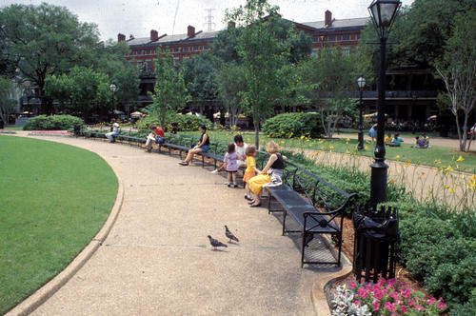
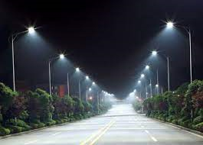
Guess what ?
Image 1
Image 2

Slide 3
Public Goods meaning
Public goods are goods that are commonly available to all people within a society or community and that possess two specific qualities: they are non-excludable and non-rivalrous.
Everyone has access to use them, and their use does not deplete their availability for future use.
Examples of Public Goods:
Law enforcement,
National defense,
Rule of law
Street lighting
Emergency services
National defense

Slide 4
characteristics
NON-EXCLUDABILITY
NON-RIVALRY
FREE RIDER PROBLEM

Slide 5
NON-EXCLUDABILITY
Producer of the good is unable to prevent others from using it. For instance, it would be extremely difficult to prevent each person from using a traffic light.
Doing so would require extreme levels of management and prevent the use of certain roads.

Slide 6
Non-rivalry
Goods that are consumed by people but whose supply is not affected by people’s consumption.
When an individual or a group of individuals use a particular good, the supply left for other people to use remains unchanged.
Such goods can be consumed over and over again without the fear of depletion of supply.

Slide 7
Free Rider Problem
Everyone has access to them so people benefit from the good without contributing to its payment.
If certain individuals are not paying, then the rest will also be reluctant to pay

