Slide 1
Price-Output Determination under Low-Cost Price Leadership
Prepared by
ANINDITA CHAKRAVARTY

Slide 2
Economists have developed various models concerning price-output determination under price leadership making different assumptions about the behaviour of price leader and his followers. We shall first explain price-output determination under price leadership by a low-cost firm.

Slide 3
In order to simplify our analysis we make the following assumptions:
(1) There are two firms, A and B. The firm A has a lower cost of production than firm B.
(2) The product produced by the two firms is homogeneous so that the consumers have no preference between them.
(3) Each of the two firms has equal share in the market. In other words, demand curve facing each firm will be the same and will be half of the total market demand curve of product.

Slide 4
Price and output determination under price leadership is illustrated in Fig
Each firm is facing demand curve Dd which is half of the total market demand curve DD for the product. MR is the marginal revenue curve of each firm. AC_{a} and MC_{a} are the average and marginal cost curves of firm A, and AC_{b} and MC_{b} are the average and marginal cost curves of firm B. Cost curves of firm A lie below the cost curves of firm B because we are assuming that firm A has a lower cost of production than firm B.

Slide 5
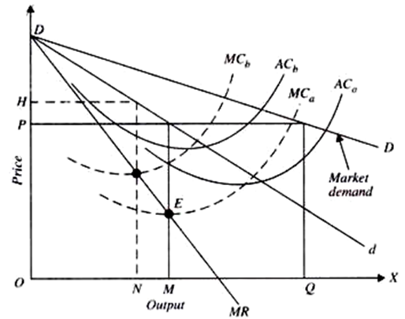

Slide 6
The firm A will be maximizing its profits by selling out­put OM and setting price OP, since at output OM, its marginal cost is equal to the marginal revenue. Firm B’s profits will be maximum when it fixes price OH and sells output ON. It will be seen from the figure that profit- maximising price OP of firm A is lower than the profit- maximising price OH of firm B. Since the two firms are produc­ing a homogeneous product, they cannot charge two differ­ent prices. Because the profit- maximising price OP of firm A is lower than the profit-maximising price OH of firm B, firm A will dictate the price to the firm B or, in other words, firm A will win if there is price war between the two and will emerge as a price leader and firm B will be compelled to follow. Given these facts, the agreement reached between them, even though tacit it may be, will require that the firm A will act as the price leader and firm B as the price follower.

Slide 7
When the products of the price leader and his price-followers are differentiated, then the price charged by them will be different but the prices charged by the followers will be only slightly different either way from that of the price leader and they will conform to a definite pattern of differentials
THANK YOU

