Slide 1
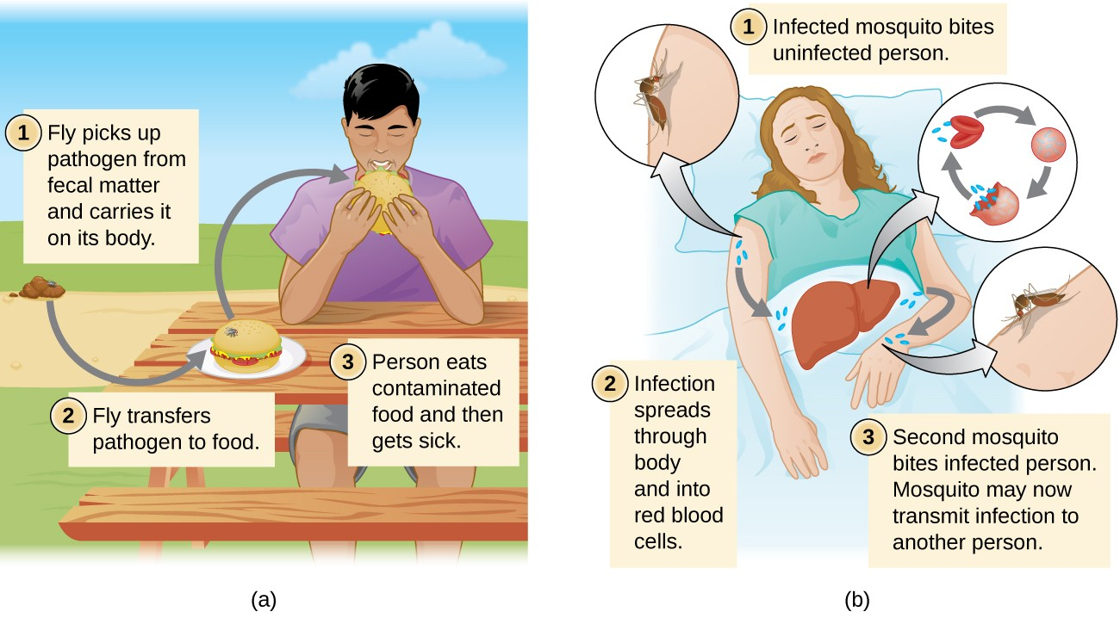
BRIEF INTRODUCTION OF CARRIER AND VECTORS
PRESENTED BY SAIMOUN

Slide 2
INTRODUCTION
Parasite :- A living organism which receives nourishment and shelter from another organism where it lives .
Classes of parasites :-
a. Ecto-parasite :Lives outside on the surface of the body of the host.
b. Endo-parasite :-Lives inside the body of the host :in blood ,tissues,body cavities,digestive tract and other organs .

Slide 4
c. Temporary parasite :-visits its host for a short period .
d. Permanent parasite :- Leads a parasitic life throughout the whole periods of its life.
e.Facultative parasite :-Lives a parasitic life when opportunity arises.
f. Obligatory parasite :- Cannot exist without a parasitic life .
g. Occasional or accidental parasite :- Attack on unusual host .

Slide 6
Host
An organism which harbours the parasite

Slide 7
CARRIER
Individual that is infected by a disease agent capable to disseminating but no sign of disease.
Carrier has no symptoms of disease but still passes it on to someone else.
It is three main types :-
True carrier :- Capable of disseminating the infection agent but never exhibit clinical sign of disease.
Incubatory carrier :-Disease in incubatory stage .
Convalescent carrier :- Clinical sign disappear.

Slide 10
VECTOR
A vector is an organism who passes on a disease without getting sick.
Actively transmits an infectious agent between infected and susceptible vertebrate.
They can serve as a vehicle where by infectious agent is conveyed from one host to another without undergoing the stage of multiplication.

Slide 16
THANKS YOU

